Slide 1
Class project
Derive and test your bedload transport relation from laboratory data

Slide 2
Part 1
I prepared an excel file called FamousDatasets.xlsx and I uploaded it in the excel_files folder of the HSI repository. You should also find it in Moodle.
In this file you will find data of famous bedload transport experiments, i.e. those performed by Meyer-Peter and Muller and those performed by Gilbert.
Part 1 of the class project consists in estimating the component of the bed shear stress in these experiments that contributed to bedload transport.

Slide 3

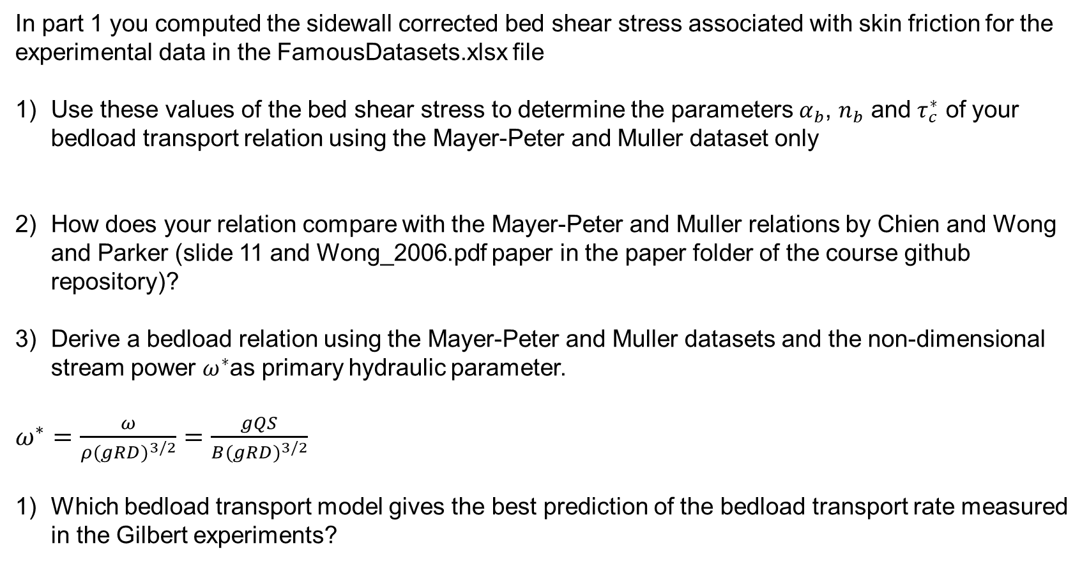
Part 2
In part 1 you computed the sidewall corrected bed shear stress associated with skin friction for the experimental data in the FamousDatasets.xlsx file
Use these values of the bed shear stress to determine the parameters $α_{b}$, $n_{b}$ and $τ_{c}^{∗}$ of your bedload transport relation using the Mayer-Peter and Muller dataset only
How does your relation compare with the Mayer-Peter and Muller relations by Chien and Wong and Parker (slide 11 and Wong_2006.pdf paper in the paper folder of the course github repository)?
Derive a bedload relation using the Mayer-Peter and Muller datasets and the non-dimensional stream power $ω^{∗}$as primary hydraulic parameter.
$ω^{∗}=\frac{ω}{ρ{(gRD)}^{3/2}}=\frac{gQS}{B{(gRD)}^{3/2}}$
Which bedload transport model gives the best prediction of the bedload transport rate measured in the Gilbert experiments?
$$q_{b}^{∗}=α_{b}{\left(τ_{s}^{∗}−τ_{c}^{∗}\right)}^{n_{b}}$$

